Slide 1
Lecture 10 Design Patterns
Dr. Hesam Chiniforooshan
se.usc.ac.ir@gmail.com

Slide 2
What is a Design Pattern?
A design pattern is a general reusable solution to a commonly occurring problem in software design.
It is not a finished design that can be transformed directly into code.
It is a description or template for how to solve a problem that can be used in many different situations.
Object-oriented design patterns typically show relationships and interactions between classes or objects, without specifying the final application classes or objects that are involved.
2

Slide 3
Classification
Creational
Deal with object creation mechanisms
Structural
Ease the design by identifying a simple way to realize relationships between entities
Behavioural
Identify common communication patterns between objects; aimed at increasing flexibility in carrying out this communication.
Architectural
Are used for software architecture

Slide 4
Classification
Creational | Structural | Behavioural | Architecture
Factory method Abstract Factory Builder Lazy Loading Object pool Prototype Singleton Multiton Resource acquisition is initialization | Adapter Bridge Composite Decorator Façade Flyweight Proxy | Null Object Null Object Command Interpreter Iterator Mediator Memento Observer State Chain of responsibility Strategy Specification Template method Visitor | Layers Presentation-abstraction-control Three-tier Pipeline Implicit invocation Blackboard system Peer-to-peer Model-View-Controller Service-oriented architecture Naked objects

Slide 5
Outline
Creational Patterns
Singleton
Lazy Loading
Factory Method
Abstract Factory
Structural Patterns
Adapter
Decorator
Behavioural
Iterator
Mediator
Memento
Strategy
Command
Architectural
MVC
Anti patterns

Slide 6
Singleton
Restricts the instantiation of a class to one "single" instance.
This is useful when exactly one object is needed to coordinate actions across the system.
The key idea in this pattern is to make the class itself responsible for controlling its instantiation

Slide 7
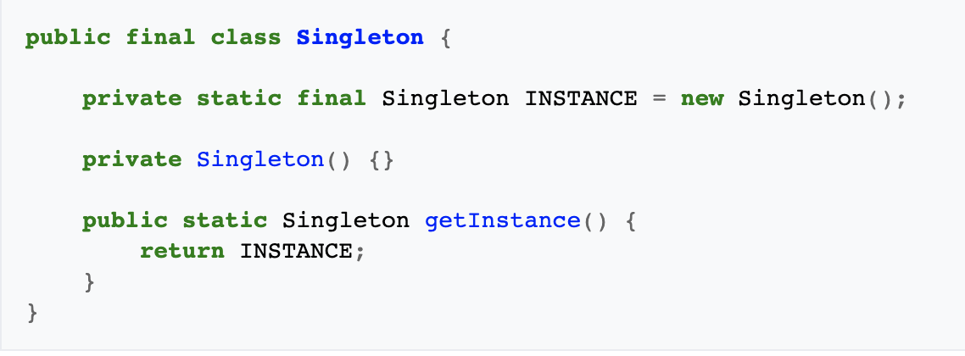
Singleton

Slide 8
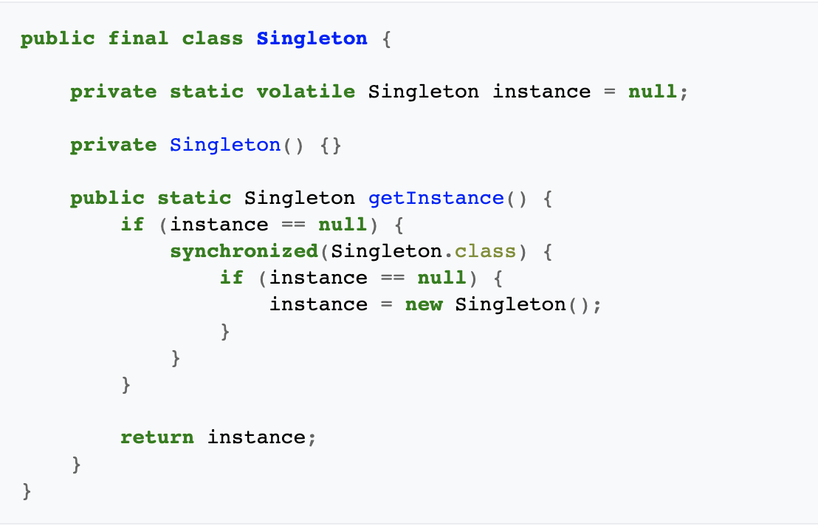
Singleton + Lazy Loading
Notes:
Lazy loading is a concept where we delay the loading of object until the point where we need it.
Lazy loading is just a fancy name given to the process of initializing a class when it’s actually needed.
In simple words, Lazy loading is a software design pattern where the initialization of an object occurs only when it is actually needed and not before to preserve simplicity of usage and improve performance.
Lazy loading is essential when the cost of object creation is very high and the use of the object is very rare. So this is the scenario where it’s worth implementing lazy loading.The fundamental idea of lazy loading is to load object/data when needed.

Slide 9
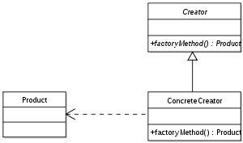
Factory Method Creational DP
Intent
Implements the concept of factory
Defines an interface for creating an object, but let client decide which class to instantiate.
The Factory method lets a class defer instantiation to clients
Problem
A framework needs to standardize the architectural model for a range of applications, but allow for individual applications to define their own domain objects and provide for their instantiation.
Structure

Slide 10
Factory Method Creational DP
public interface ImageReader {
public DecodedImage getDecodedImage();
}
public class GifReader implements ImageReader {
public DecodedImage getDecodedImage() {
// ...
return decodedImage;
}
}
public class JpegReader implements ImageReader {
public DecodedImage getDecodedImage() {
// ...
return decodedImage;
}
}
public class ImageReaderFactory {
public static ImageReader
getImageReader(InputStream is) {
int imageType = determineImageType(is);
switch (imageType) {
case ImageReaderFactory.GIF:
return new GifReader(is);
case ImageReaderFactory.JPEG:
return new JpegReader(is);
// etc.
}
}
}

Slide 11
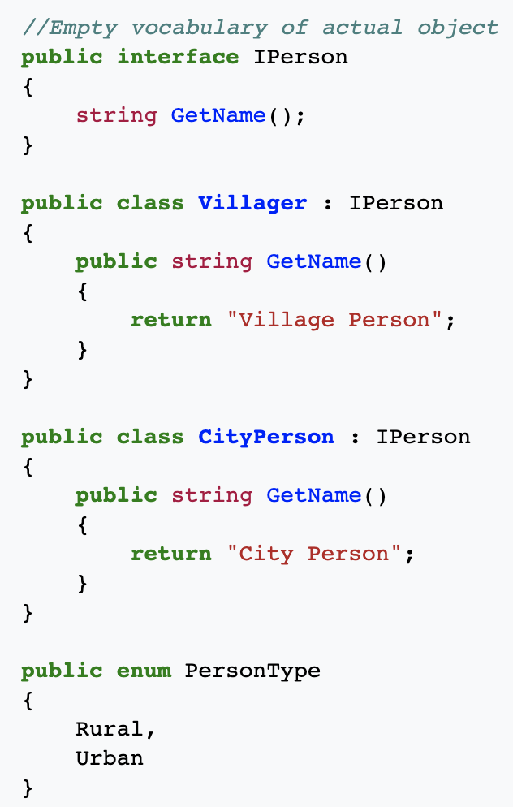
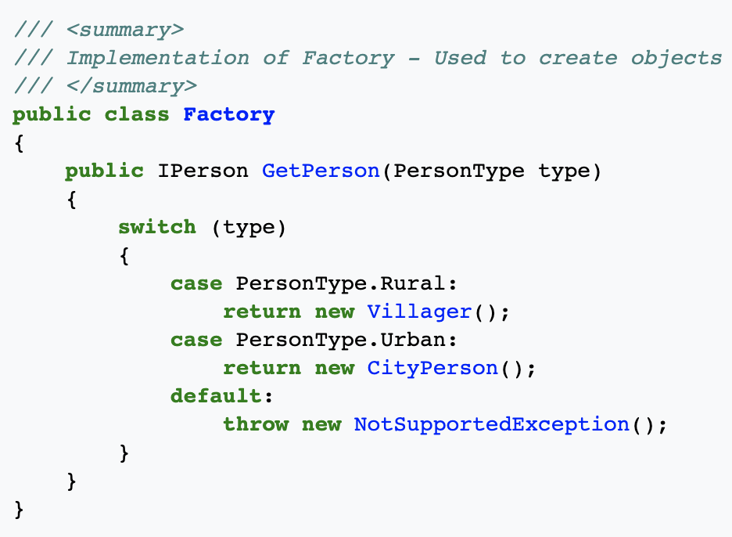
Factory Method Creational DP

Slide 12
Abstract Factory Creational DP
Intent
Provide an interface for creating families of related or dependent objects without specifying their concrete classes.
Problem
When clients cannot anticipate groups of classes to instantiate
If an application is to be portable, it needs to encapsulate platform dependencies. These “platforms” might include: windowing system, operating system, database, etc.

Slide 13
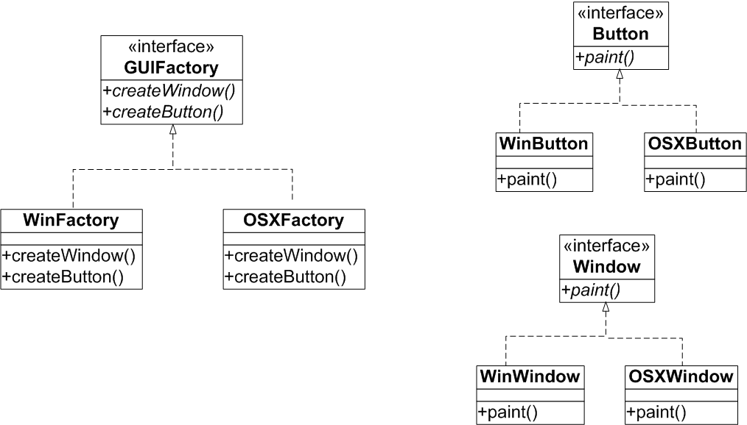
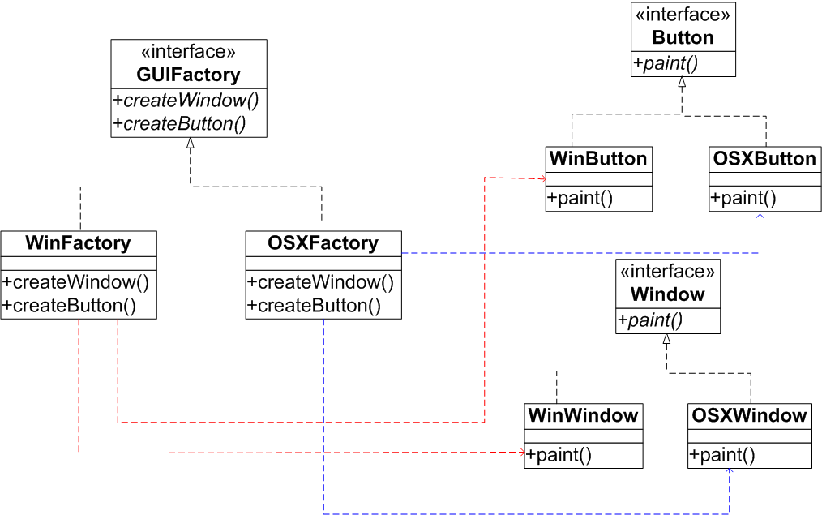
Abstract Factory Creational DP
Design a portable GUI system which paints windows and buttons on different operating systems.

Slide 14
Abstract Factory Creational DP
interface GUIFactory {
public Button createWindow();
public Button createButton();
}
class WinFactory implements GUIFactory {
public Button createButton() {
return new WinButton();
}
public Button createWindow() {
return new WinWindow();
}
}
class OSXFactory implements GUIFactory {
public Button createButton() {
return new OSXButton();
}
public Button createWindow() {
return new OSXWindow();
}
}
interface Button {
public void paint();
}
class WinButton implements Button {
public void paint() {
// …
}
}
class OSXButton implements Button {
public void paint() {
// ….
}
}
interface Window {
public void paint();
}
class WinWindow implements Window {
// . . .
}
class OSXWindow implements Window {
//..
}

Slide 15
Outline
Creational Patterns
Singleton
Lazy Loading
Factory Method
Abstract Factory
Structural Patterns
Adapter
Decorator
Behavioural
Iterator
Mediator
Memento
Strategy
Command
Architectural
MVC
Anti patterns

Slide 16
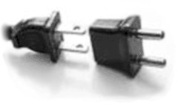
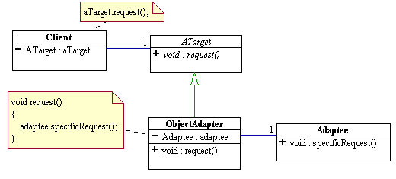
Adapter Structural DP
Intent
Convert the interface of a class into another interface clients expect.
Wrap an existing class with a new interface.
Adapter lets classes work together that couldn't otherwise because of incompatible interfaces.
Problem
An “off the shelf” component offers compelling functionality that you would like to reuse, but its “view of the world” is not compatible with the design of the system currently being developed.
Reuse of legacy components
Notes:
The adapter inherits the target interface that the client expects to see, while it holds an instance the adaptee. When the client calls the request() method on its target object (the adapter), the request is translated into the corresponding specific request on the adaptee.

Slide 17
Adapter Structural DP
a legacy Rectangle component’s display() method expects to receive “x, y, w, h” parameters. But the client wants to pass “upper left x and y” and “lower right x and y”. This incongruity can be reconciled by adding an additional level of indirection – i.e. an Adapter object.
Client
<<Interface>>
Shape
+ display(int x1, int y1, int x2, int y2)
Rectangle
LegacyRectangle
+ display(int x1, int y1, int x2, int y2)
+ display(int x1, int y1, int h, int w)

Slide 18
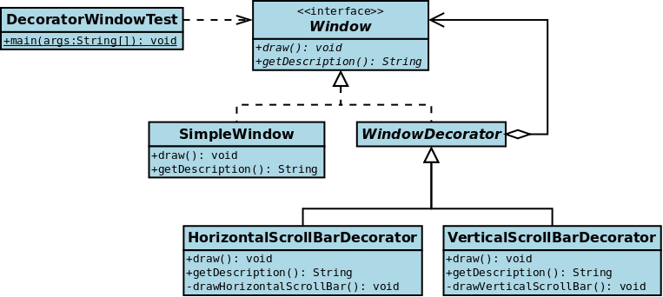
Decorator Structural DP
Intent
Adding additional functionality to a particular object as opposed to a class of objects
Problem
You want to add behavior or state to individual objects at run-time. Inheritance is not feasible because it is static and applies to an entire class.

Slide 19
Decorator Structural DP
// the Window interface
interface Window {
public void draw(); // draws the Window
public String getDescription(); // returns a description of the Window
}
// implementation of a simple Window without any scrollbars
class SimpleWindow implements Window {
public void draw() {
// draw window
}
public String getDescription() {
return "simple window";
}
}

Slide 20
Decorator Structural DP
// abstract decorator class - note that it implements Window
abstract class WindowDecorator implements Window {
protected Window decoratedWindow; // the Window being decorated
public WindowDecorator (Window decoratedWindow) {
this.decoratedWindow = decoratedWindow;
}
public void draw() {
decoratedWindow.draw();
}
}
// the first concrete decorator which adds vertical scrollbar functionality
class VerticalScrollBarDecorator extends WindowDecorator {
public VerticalScrollBarDecorator (Window decoratedWindow) {
super(decoratedWindow);
}
public void draw() {
decoratedWindow.draw();
drawVerticalScrollBar();
}
private void drawVerticalScrollBar() {
// draw the vertical scrollbar
}
}

Slide 21
Decorator Structural DP
public class DecoratedWindowTest {
public static void main(String[] args) {
// creating an object to be decorated later
Window simpleWindow1 = new new SimpleWindow();
// decorating the simple window with a vertical scroll Bar
Window VSB_decoratedWindow = new VerticalScrollBarDecorator(simpleWindow1);
VSB_decoratedWindow.draw();
// further decorating the window with a horizontal Scroll Bar ???
Window HSB-VSB-decoratedWindow = new HorizontalScrollBarDecorator(VSB_decoratedWindow1 );
HSB-VSB-decoratedWindow.draw();
}
}

Slide 22
Outline
Creational Patterns
Singleton
Lazy Loading
Factory Method
Abstract Factory
Structural Patterns
Adapter
Decorator
Behavioural
Iterator
Mediator
Memento
Strategy
Command
Architectural
MVC
Anti patterns

Slide 23
Iterator Behavioural DP
Intent
Provide a way to access the elements of an aggregate object (container) sequentially without exposing its underlying representation
Problem
Need to “abstract” the traversal of wildly different data structures so that algorithms can be defined that are capable of interfacing with each transparently.

Slide 24
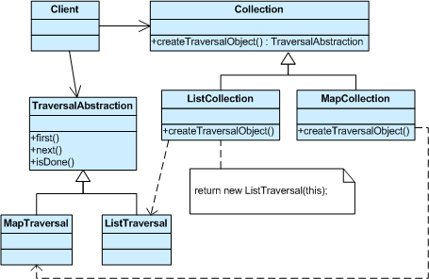
Iterator Behavioural DP

Slide 25
Iterator
Java Array List Iterator
ArrayList al = new ArrayList(); // add elements to the array list al.add("C"); al.add("A"); al.add("E"); al.add("B"); al.add("D"); al.add("F");
// use iterator to display contents of al System.out.print("Original contents of al: "); Iterator itr = al.iterator(); while(itr.hasNext()) { Object element = itr.next(); System.out.print(element + " "); }

Slide 26
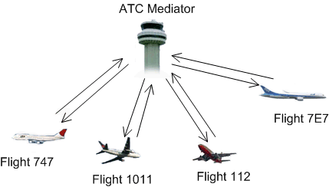
Mediator Behavioural DP
Intent
Define an object that encapsulates how a set of objects interact.
Mediator promotes ???
loose coupling by keeping objects from referring to each other explicitly, and it lets you vary their interaction independently.
Problem
We want to design reusable components, but dependencies between the potentially reusable pieces demonstrates the “spaghetti code” phenomenon

Slide 27

Mediator Behavioural DP

Slide 28
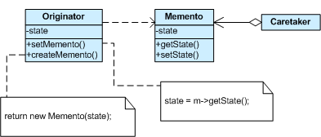
Memento Behavioural DP
Intent
Memento DP provides the ability to restore an object to its previous state (undo via rollback).
A magic cookie that encapsulates a “check point” capability.
The Memento design pattern defines three distinct roles:
Originator - the object that knows how to save itself.
Caretaker - the object that knows why and when the Originator needs to save and restore itself.
Memento - the lock box that is written and read by the Originator, and controlled by the Caretaker.

Slide 29
Memento Behavioural DP
class Memento {
private String state;
public Memento(String stateToSave) { state = stateToSave; }
public String getSavedState() { return state; }
}
class Originator {
private String state;
public Memento saveToMemento() {
System.out.println("Originator: Saving to Memento.");
return new Memento(state);
}
public void restoreFromMemento(Memento m) {
state = m.getSavedState();
System.out.println("Originator: State after restoring from Memento: "+state);
}
public void set(String state) {
System.out.println("Originator: Setting state to "+state);
this.state = state;
}
}

Slide 30
Memento Behavioural DP
class Caretaker {
private ArrayList<Memento> savedStates = new ArrayList<Memento>();
public void addMemento(Memento m) { savedStates.add(m); }
public Memento getMemento(int index) { return savedStates.get(index); }
}
class MementoExample {
public static void main(String[] args) {
Caretaker caretaker = new Caretaker();
Originator originator = new Originator();
originator.set("State1");
originator.set("State2");
caretaker.addMemento( originator.saveToMemento() );
originator.set("State3");
caretaker.addMemento( originator.saveToMemento() );
originator.set("State4");
originator.restoreFromMemento( caretaker.getMemento(1) );
}
}

Slide 31
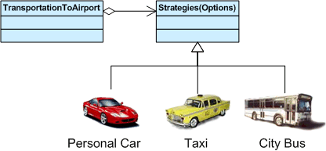
Strategy Behavioural DP
Intent
Define a family of algorithms, encapsulate each one, and make them interchangeable to let clients and algorithms vary independently
Applicability
When an object should be configurable with one of several algorithms and:
All algorithms can be encapsulated
One interface covers all encapsulations

Slide 32
Strategy Behavioural DP
Consequences
Greater flexibility, reuse
Can change algorithms dynamically
Strategy creation & communication overhead
Inflexible strategy interface

Slide 33
Command Behavioural DP
Intent
Encapsulate a request as an object, thereby letting you parameterize clients with different requests, queue or log requests, and support undoable operations.
Problem
Need to issue requests to objects without knowing anything about the operation being requested or the receiver of the request.
When two objects communicate, often one object is sending a command to the other object to perform a particular function
The first object (the “invoker") to hold a reference to the second (the "recipient")
The invoker executes a specific method on the recipient to send the command.
What if the invoker is not aware of, or does not care who the recipient is?
The invoker simply wants to abstractly issue the command
E.g. Program Menu

Slide 34
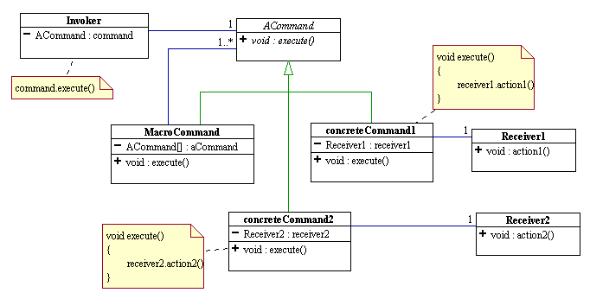
Command Behavioural DP
The Command design pattern encapsulates the concept of the command into an object. The invoker holds a reference to the command object rather than to the recipient.
The invoker sends the command to the command object by executing a specific method on it. The command object is then responsible for dispatching the command to a specific recipient to get the job done.
Notes:
Command and Memento act as magic tokens to be passed around and invoked at a later time. In Command, the token represents a request; in Memento, it represents the internal state of an object at a particular time.
Command can use Memento to maintain the state required for an undo operation.

Slide 35
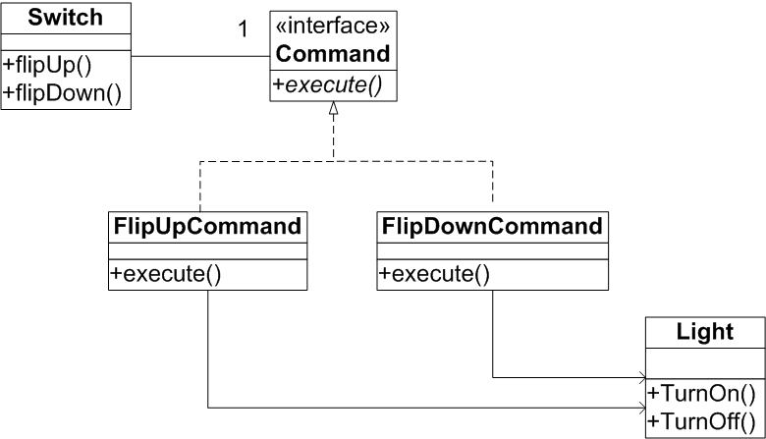
Command Behavioural DP
Design a switching system for turning on and off a light. Make the switch as reusable as possible (the same switch can be used for turning on and off an engine)

Slide 36
Command Behavioural DP
Design a switching system for turning on and off a light. Make the switch as reusable as possible (the same switch can be used for turning on and off an engine)
/* The Invoker class */
public class Switch {
private Command flipUpCommand;
private Command flipDownCommand;
public Switch(Command flipUpCmd, Command flipDownCmd) {
this.flipUpCommand = flipUpCmd;
this.flipDownCommand = flipDownCmd;
}
public void flipUp() {
flipUpCommand.execute();
}
public void flipDown() {
flipDownCommand.execute();
}
}

Slide 37
Command Behavioural DP
/* The Command interface */
public interface Command {
void execute();
}
/* The Command for turning the light on */
public class FlipUpCommand implements Command {
private Light theLight;
public FlipUpCommand(Light light) {
this.theLight=light;
}
public void execute(){
theLight.turnOn();
}
}
/* The Command for turning the light off */
public class FlipDownCommand implements Command {
private Light theLight;
public FlipDownCommand(Light light) {
this.theLight=light;
}
public void execute() {
theLight.turnOff();
}
}

Slide 38
Outline
Creational Patterns
Singleton
Lazy Loading
Factory Method
Abstract Factory
Structural Patterns
Adapter
Decorator
Behavioural
Iterator
Mediator
Memento
Strategy
Command
Architectural
MVC
Anti patterns

Slide 39





Model-View-Controller (MVC) Architectural DP
Application presents content to users in numerous ways containing various data.
Classic Web customer
Mobile customer
Rich Web customer
Administrator
Supplier B2B agent
HTML web view
WML web view
RAP web view
JFC/Swingview
Web Service
Enterprise information system
39

Slide 40
MVC
Model
Encapsulates application state
Responds to state queries
Exposes application functionality
Notifies views of changes
State query
State change
Change notification
View
Renders the models
Requests updates from models
Sends gestures to controller
Allows controller to select view
Controller
Defines application behavior
Maps user actions to model updates
Selects view for response
One for each functionality
View selection
User gestures

Slide 41
Outline
Creational Patterns
Singleton
Lazy Loading
Factory Method
Abstract Factory
Structural Patterns
Adapter
Decorator
Behavioural
Iterator
Mediator
Memento
Strategy
Command
Architectural
MVC
Anti patterns

Slide 42
AntiPatterns
An industry vocabulary for the common defective processes and implementations within organizations.
A higher-level vocabulary simplifies communication between software practitioners and enables concise description of higher-level concepts.
The AntiPattern may be the result of a manager or developer:
Not knowing any better
Not having sufficient knowledge or experience in solving a particular type of problem
Having applied a perfectly good pattern in the wrong context.

Slide 43



AntiPatterns
Software Development AntiPatterns
Describe useful forms of software refactoring
A concept similar to Code Smell
Software Architecture AntiPatterns
focus on the system-level and enterprise-level structure of applications and components.
Software Project Management AntiPatterns
Identify some of the key scenarios in which human-related issues are destructive to software processes.

Slide 44
AntiPatterns
Sftwr Dev. APs
The Blob
Continuous Obsolescence
Lava Flow
Ambiguous Viewpoint
Functional Decomposition
Poltergeists
Boat Anchor
Golden Hammer
Dead End
Spaghetti Code
Input Kludge
Walking through a Minefield
Cut-And-Paste Programming
Mushroom Management
Sftwr Arch. AP
Autogenerated Stovepipe
Stovepipe Enterprise
Jumble
Stovepipe System
Cover Your Assets
Vendor Lock-In
Wolf Ticket
Architecture By Implication
Warm Bodies
Design By Committee
Swiss Army Knife
Reinvent The Wheel
The Grand Old Duke of York
Prjct Mngmnt APs
Blowhard Jamboree
Analysis Paralysis
Viewgraph Engineering
Death By Planning
Fear of Success
Corncob
Intellectual Violence
Irrational Management
Smoke and Mirrors
Project Mismanagement
Throw It over the Wall
Fire Drill
The Feud
E-mail Is Dangerous

Slide 45

Golden Hammer Software Development AP
A software development team has gained a high level of competence in a particular solution or vendor product, referred to here as the Golden Hammer
As a result, every new product or development effort is viewed as something that is best solved with it.
Results:
The misapplication of a favored tool or concept.
Developers and managers are comfortable with an existing approach and unwilling to learn and apply one that is better suited.

Slide 46
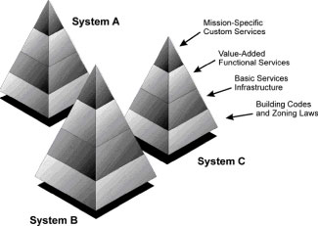

Stovepipe Enterprise Software Architecture AP
Describe software systems with ad hoc architectures
Multiple systems within an enterprise are designed independently at every level.
Lack of commonality:
Inhibits interoperability between systems, prevents reuse, and drives up cost;
Reinvented system architecture and services lack quality structure supporting adaptability.
“We’re unique!”
Notes:
Since wood burning produces corrosive substances that erode metal, a stovepipe must be constantly maintained and repaired in order to avoid leakage. Often, the pipes are repaired with any materials at hand, thus wood-burning stovepipes quickly become a hodgepodge of ad hoc repairs—hence, the reference is used to describe the ad hoc structure of many software systems.

Slide 47

Analysis Paralysis Project Management AP
Occurs when the goal is to achieve perfection and completeness of the analysis phase.
Is characterized by turnover, revision of the models, and the generation of detailed models that are less than useful to downstream processes.
“We need to”:
Redo this analysis to make it more object-oriented, and use much more inheritance to get lots of reuse
complete object-oriented analysis, and design before we can begin any coding
Consider all alternative decisions that user may take
Identify the exact details of problems statement, right now.
. . . MAYBE WE DON’T NEED ANY OF THESE !!!

Slide 48
Sources
http://sourcemaking.com/
http://en.wikipedia.org/wiki/Design_pattern_(computer_science)
Erich Gamma, Richard Helm, Ralph Johnson, and John Vlissides (Gang of Four (GoF)) Elements of Reusable Object-Oriented Software

